Slide 1

Oracle Application Express (Oracle APEX)
Fully supported no-cost feature of Oracle DB
Distributed with
Oracle Enterprise Edition
Oracle Standard Edition
Oracle Standard Edition One
Oracle XE
Supported Database Releases
10gR2
11gR1 and 11gR2
12c
Notes:
Fully supported available using Oracle Database support agreement, with dedicated support team
“No-Cost” Feature means you can build any number of applications and any number of users without additional licensing costs
Runs in all database editions
Requires 10.2.0.4 and above
Part of standard database install since 11gR1
As APEX released more frequently than database should always update to the latest version of APEX available on OTN
[http://www.oracle.com/technetwork/developer-tools/apex/downloads/index.html]

Slide 2
Oracle Application Express (Oracle APEX)
History
HTML DB 1.5
First Release
HTML DB 1.6
Themes
Application Express 2.1
Oracle XE
Application Express 2.2
Packaged Applications
Application Express 3.1
Interactive Reports
Application Express 4.0
Websheets
Dynamic Actions
Plug-Ins
Team Development
Application Express 4.2
Mobile
HTML5
Packaged Apps
2004
2005
2006
2007
2008
2009
2010
2011
2012
HTML DB 2.0
SQL Workshop
Application Express 3.0
Flash Charts
PDF Printing
Access Migration
Application Express 3.2
Oracle Forms to APEX Conversion
Application Express 4.1
Data Upload
Error Handling
ROWID
Notes:
Generally release a new version of APEX annually
* Next release will be APEX 5.0 – See Statement of Direction for more details
[http://www.oracle.com/technetwork/developer-tools/apex/application-express/apex-sod-087560.html]

Slide 3
Oracle Application Express (Oracle APEX)
Community
Estimated 400,000 developers worldwide
Over 120 consulting companies worldwide
Over 75 bloggers
3rd most popular forum on OTN
Web sites dedicated to plug-ins, themes, tools
Notes:
Number of developers a guesstimate as one download from OTN can be used by any number of developers and may be using the version that came with Database
Impressive number of consulting companies and bloggers for a single tool
Most popular forums on OTN are: General Database; SQL and PL/SQL; APEX
- Community based tool as seen by support on OTN Forum where there is a wealth of information
– Can ask simple and advanced questions and get responses from numerous experts around the world including the APEX Development Team

Slide 4
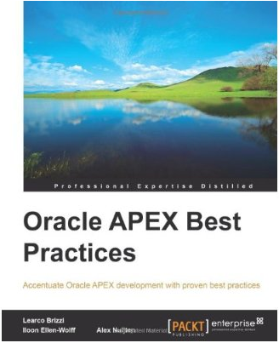
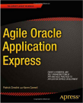

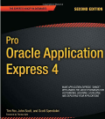
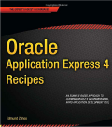
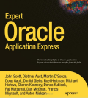
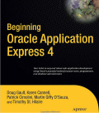
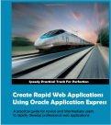
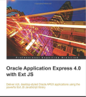
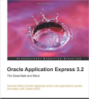
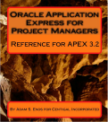
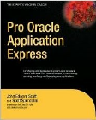
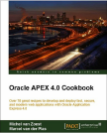
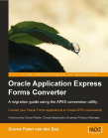
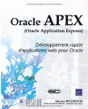


Oracle Application Express (Oracle APEX)
Books
Notes:
Number of books on APEX is impressive for a single Oracle tool
The number of books continues to grow with several new books in the pipeline

Slide 5
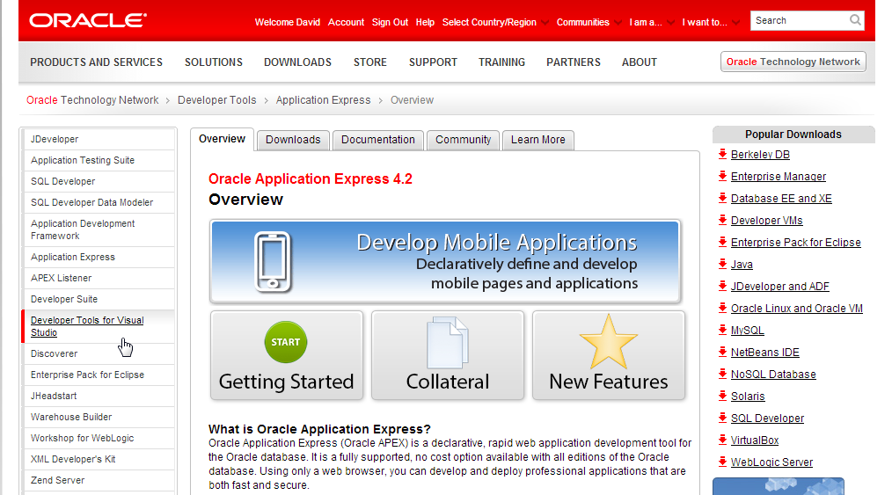
Oracle Technology Network (OTN)
http://otn.oracle.com/apex
Notes:
APEX OTN Site is rigorously maintained and has an extensive array of information
Increasing number of Case Studies and other general information like Getting Started page
Collateral includes technical information, white papers, videos, and presentations
Deployment has details on installation, upgrades, deploying applications, UI, security and performance
Download Tab has the latest APEX version, Known Issues, etc
Community Tab lists consulting companies, commercial applications, public websites, hosting companies and community articles

Slide 6
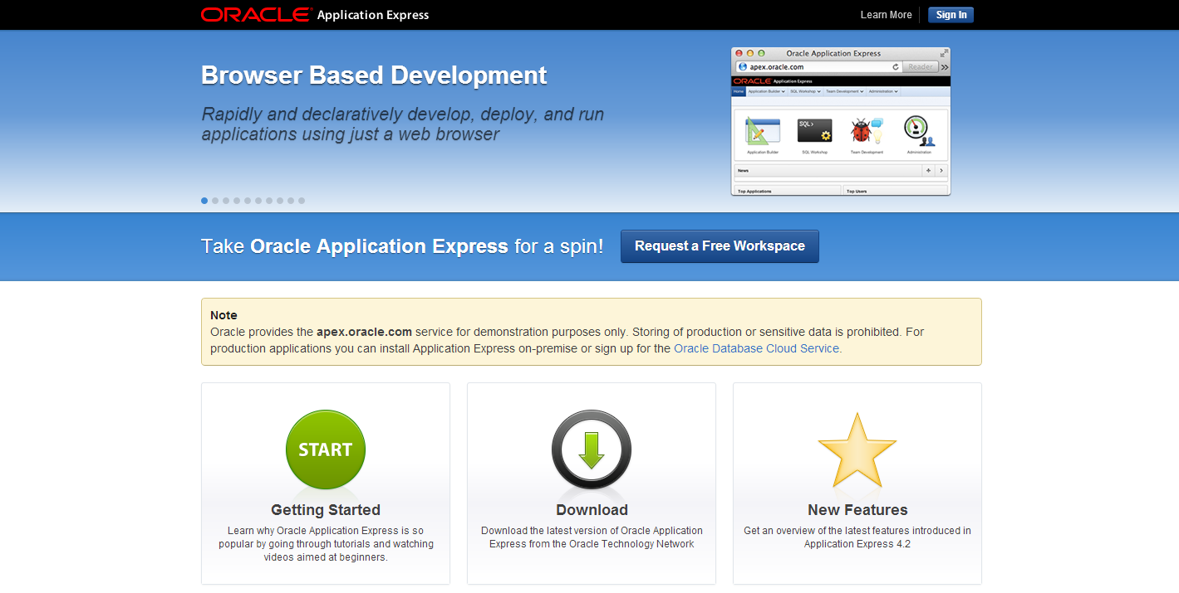
http://apex.oracle.com
Notes:
Apex.oracle.com is a free “Development Only” service.
Service has been running for over 10 years allowing developers to “kick the tires” with the latest version of APEX
Over 15,000 workspaces and > 6 million page views / week
Sign-up for an account to be able to start playing with APEX in minutes

Slide 7
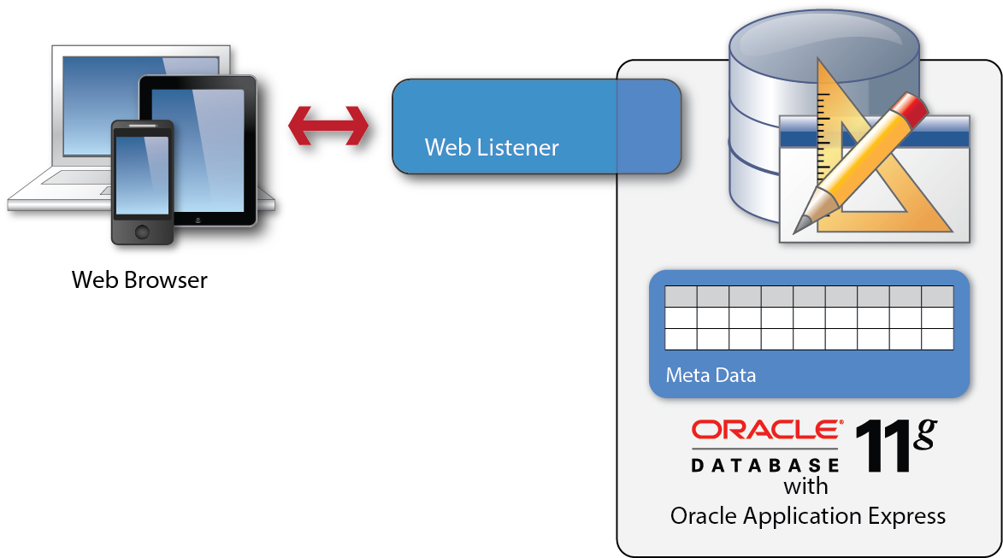
Oracle Application Express (Oracle APEX)
Architectural Overview
Simple 2-Tier Architecture
Pages dynamically rendered using database metadata
No code generation or file based compilation
Runs everywhere Oracle Database runs
Notes:
Simple architecture where browser goes through web listener to database – Web listener only used to pipe requests and send responses; no business logic
Each page request or submission dynamically reads metadata for the page, performs the necessary query or processing and returns the results.
As soon as you update the metadata can run immediately as no need to perform any code generation or file compilation

Slide 8

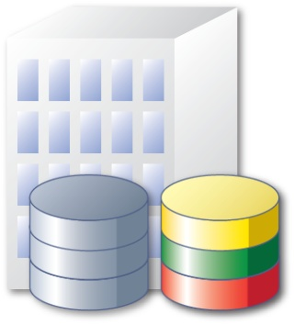
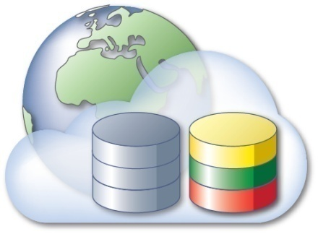
Oracle Application Express (Oracle APEX)
Development / Deployment Options
Locally
Install on Stand-alone machine
Multi-tenant Private Cloud
Workspaces for each department
Self-service provisioning model
Public Cloud
Oracle Database Cloud Service
Hosting partners
Amazon EC2 / RDS
Notes:
Given APEX can run anywhere you can install the Oracle Database you have great flexibility
Start developing on your laptop running Oracle XE or on the cloud and then simply export the application
Import into any other Oracle Database where you have the same version or later of Application Express installed
Deploy on the Oracle Database Cloud Service and then once your application gets wide utilization move it to your private cloud.

Slide 9
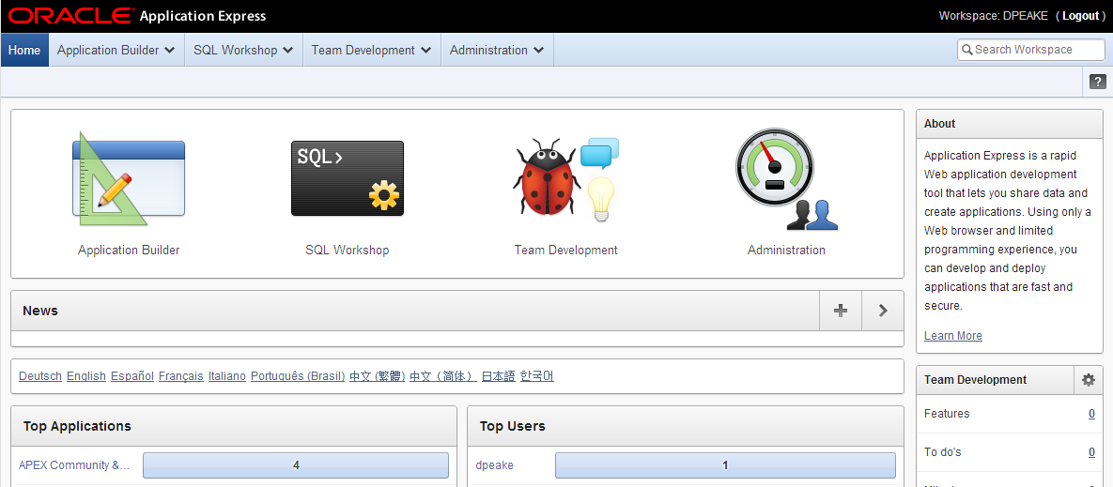
Oracle Application Express (Oracle APEX)
Browser Based Application Development / Runtime
Notes:
You do not need any client software – simply a web browser and URL to access development environment and to run applications

Slide 10
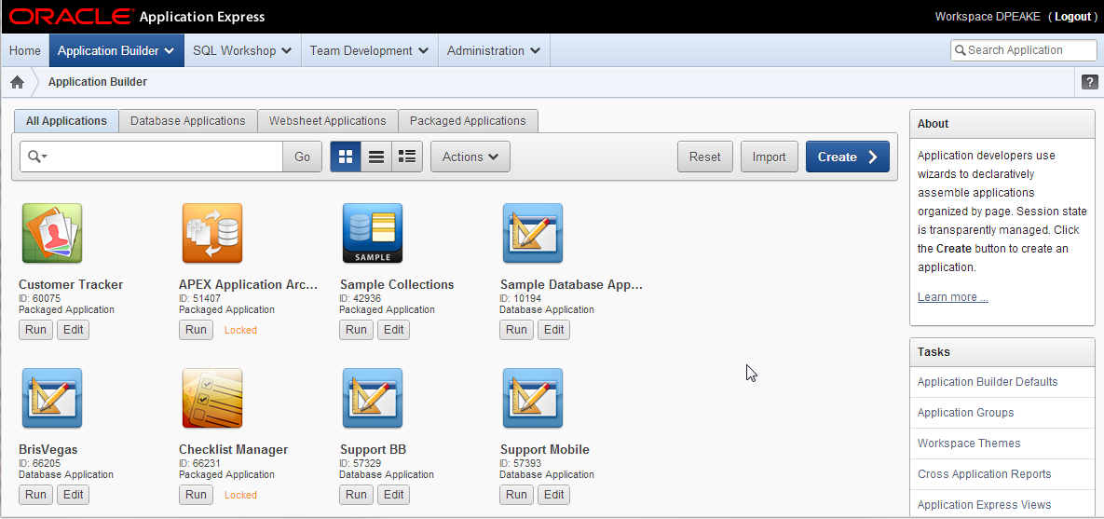
Oracle Application Express (Oracle APEX)
Component: Application Builder
Notes:
Go here to rapidly build declarative applications based on your Oracle Database tables

Slide 11
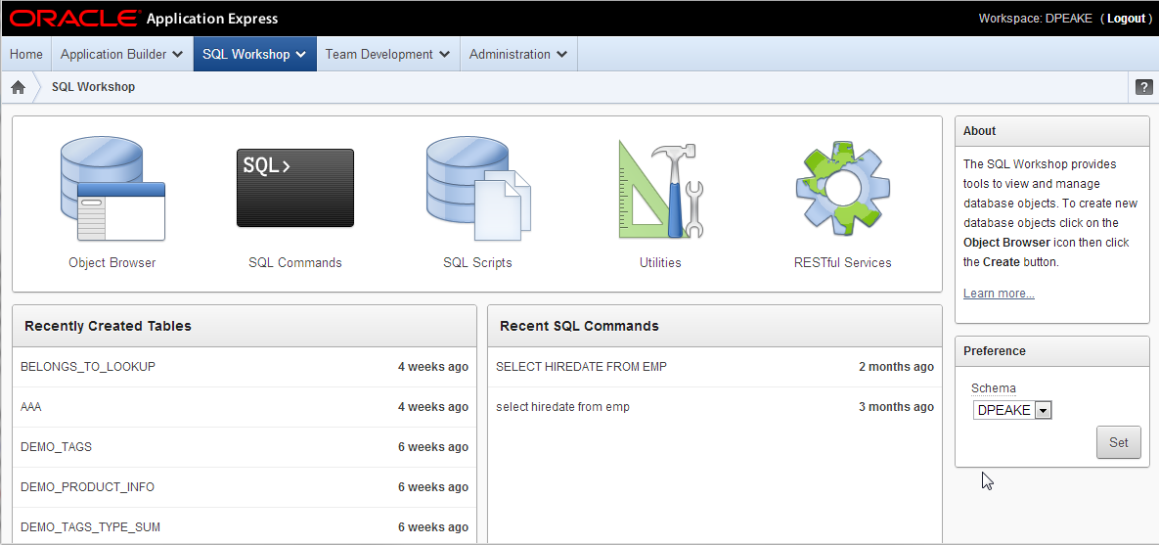
Oracle Application Express (Oracle APEX)
Component: SQL Workshop
Notes:
SQL Workshop is designed to allow Application Developers to maintain database objects such as tables, packages, functions, views, etc
Not as fully featured as a dedicated tool such as SQL Developer but has all the essentials for browsing, creating and maintaining DB objects
Essential when direct access to underlying schemas not provided such as for hosted environments like apex.oracle.com
- Object Browser to review and maintain DB Objects
- SQL Commands to run SQL
- SQL Scripts to upload and execute script files
Utilities include Query Builder, Data Workshop, Generate DDL, Schema Comparison and more
RESTful Services to define Web Services using SQL and PL/SQL against the database

Slide 12
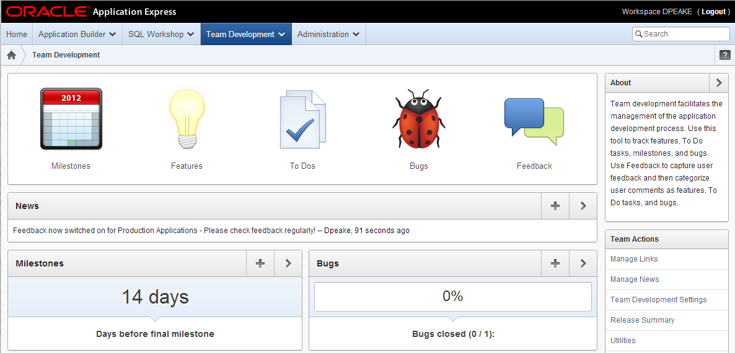
Oracle Application Express (Oracle APEX)
Component: Team Development
Notes:
Team Development allows development teams to better manage their APEX projects by defining milestones, features, to-dos and bugs
Features, to-dos and bugs can be associated with specific applications and pages as necessary
Developers can readily configure feedback to allow their end-users to provide comments on applications.
The feedback also captures relevant session state details and can be readily converted to a feature, to-do or bug.

Slide 13
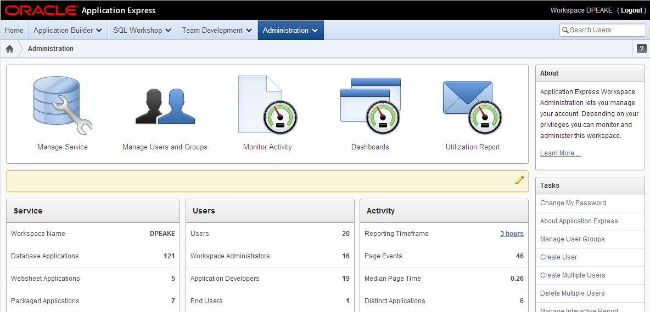
Oracle Application Express (Oracle APEX)
Component: Administration and Analytics
Notes:
Workspace Administrators can administer their workspace and use the various reports to monitor activity
Manage Service allows them to request more space or access to another schema
Manage Users and Groups allows them to define developers and end-users

Slide 14

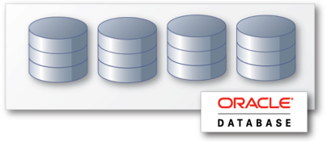
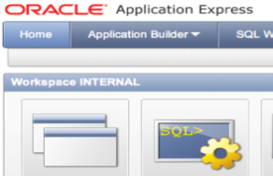
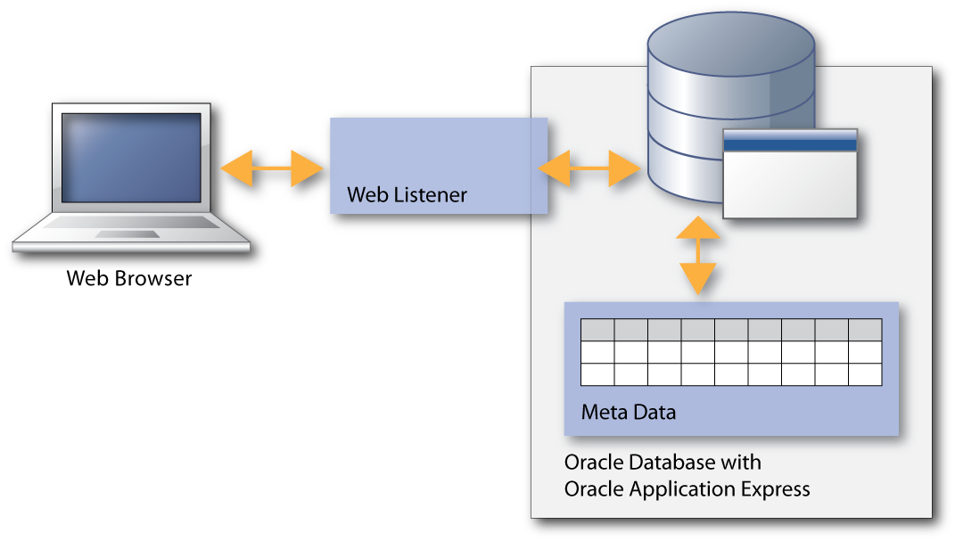
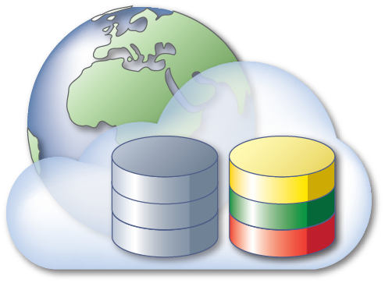
Oracle Application Express (Oracle APEX)
Benefits
Rapid Browser Based Development
Leverage SQL Skills
Point your browser and start developing
Build reports and charts using SQL
Runs within Database
Self Service Provisioning
Simple to manage, highly scalable
Out-of-the-box elastic private cloud service
Notes:
- Rapid “declarative” environment with numerous wizards to define pages and regions - Extend report source, validations, processes, etc using SQL and PL/SQL or call packages, functions in the Oracle Database
APEX lives within the Oracle Database making it easy for DBAs to manage and at the data source making it very scalable
Can readily configure provisioning to allow access across your organization from a single Oracle instance

Slide 15
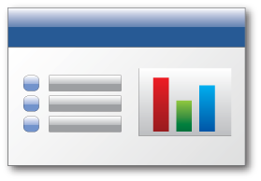


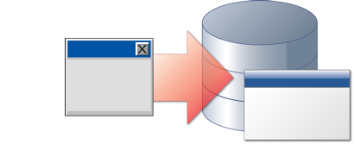

Oracle Application Express (Oracle APEX)
Use Cases
Data-driven Applications
Develop opportunistic and departmental productivity applications
Online Reporting
Build SQL-based reporting applications on existing database schemas
Spreadsheet Web-ification
Convert spreadsheets to Web applications where they can be concurrently viewed and edited
Access Replacement
Consolidate outgrown Access applications to the Oracle database with an APEX Web front end
Oracle Forms Modernization
Leverage SQL & PL/SQL declarative programming skills to move Forms applications to HTML / Web 2.0
Notes:
With Application Express you can build very simple applications, say by converting a spreadsheet, to extremely complex applications that integrate with several other systems
Rapidly develop applications on top of Oracle Tables
Provide “Interactive” reporting capabilities
Convert a spreadsheet to run on the Oracle database and provide a single source of truth
Rearchitect your Forms applications and re-use all of the existing database objects using a tool that Forms developers can easily learn and relate to as SQL and PL/SQL based
Improve security and performance of Access applications by converting them to Oracle using SQL Developer to define the data structures and migrate data and APEX to build the applications on top of

Slide 16
Oracle Application Express (Oracle APEX)
Out of the Box Development Features
Reports
Validations
Translation Services
Forms
Processes
Conditional Processing
Charts
Computations
Authentication
Calendar
Branches
Authorization
Templates
Web Services
Session State Management
Navigation
Email Services
Logging & Monitoring
Notes:
Just about every RAD tool can quickly build the components listed on the left-hand side using wizards just like APEX
However, for those components in the center many require significant hand-coding, whereas APEX handles such features declaratively
Then when you look at the components on the right-hand side this is where APEX separates itself from the rest
- The translation services within APEX allow developers to use one code base and deliver mulitple languages
- Conditional processing is available on almost every component - From pages to items, including processing can have simple “is null” to complex conditions such as calls to Oracle database functions
- Build-in Authentication themes, authorization schemes, and session state management make it easy to secure and manage user sessions allowing developers to concentrate on solving the business solutions rather than coding all of the plumbing required

Slide 17
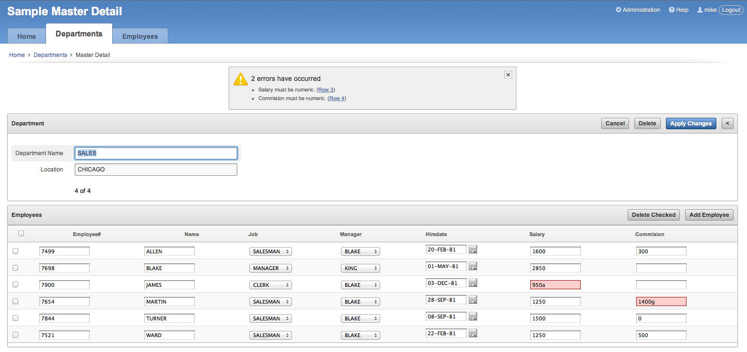
Oracle Application Express (Oracle APEX)
Advanced Master Detail with Declarative Validations
Notes:
Quickly build pages to manage parent-child relationships

Slide 18
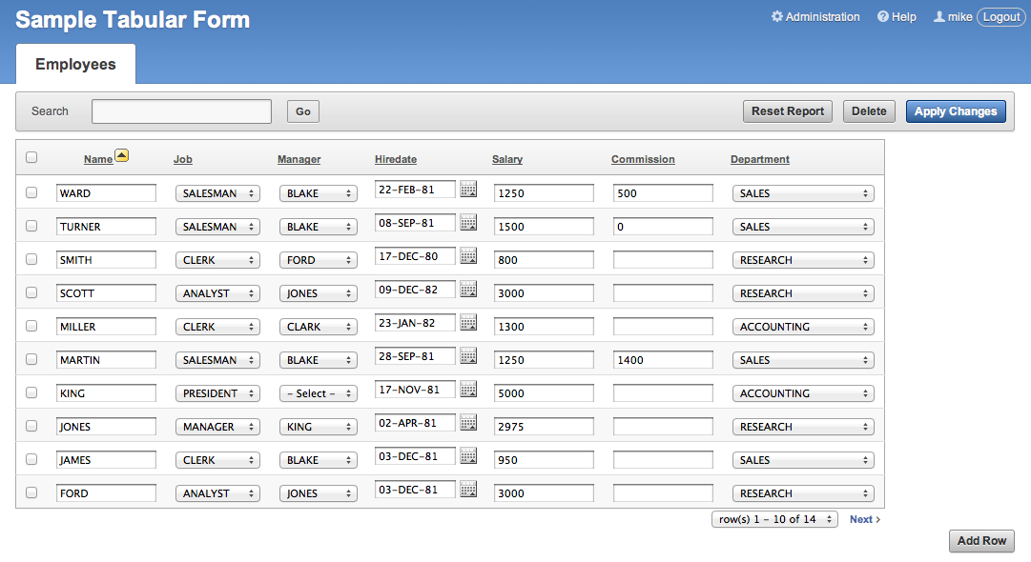
Oracle Application Express (Oracle APEX)
Declarative Tabular Forms
Notes:
Build tabular forms and like the master-detail forms you can declaratively define validations using columns.

Slide 19
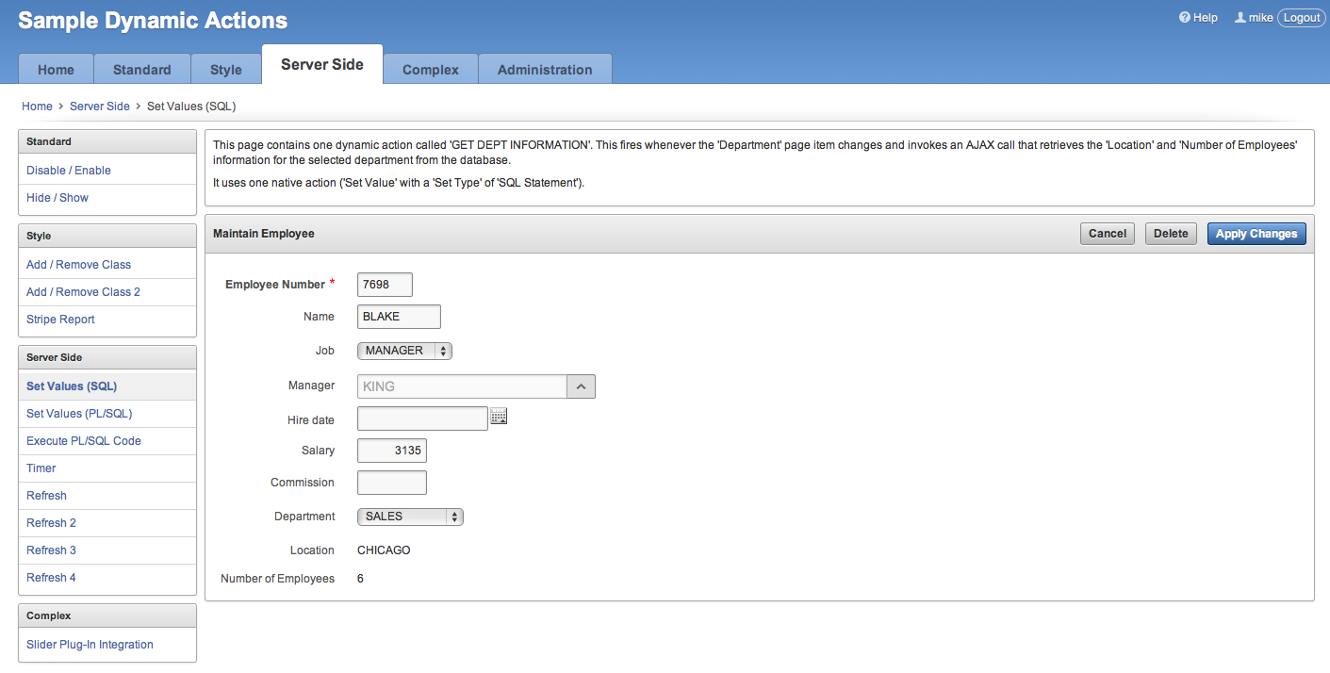
Oracle Application Express (Oracle APEX)
Declarative Javascript and AJAX with Dynamic Actions
Notes:
Incorporate client-side interactivity declaratively and without needing Javascript or AJAX.
Rather than writing lines and lines of Javascript and AJAX that is hard to maintain and needs JS skills use the simple wizards and declarative constructs to specify when to fire, what to do, and what to operate on.
Simple examples include enabling/disbaling Commission field when Job = SALESMAN; AJAX call to retrieve Location and Number of Employees when Department changed.

Slide 20

Oracle Application Express (Oracle APEX)
Mobile Support
Declarative support for building mobile web applications
APEX Applications support multiple user interfaces: e.g. Desktop and Smartphone
Mobile pages use jQuery Mobile through jQuery Mobile based themes and templates
HTML5 charts and new HTML5 item types
Notes:
The Application Builder is enhanced to support the declarative building of mobile applications. Among the numerous changes made are: Updated Create Application wizard to support generation of applications for Desktop or Mobile; Updated Create Page and Region wizards, to expose Components applicable to Mobile applications
By incorporating jQuery Mobile application wills render correctly on all mobile devices, old and new. Applications will run on iOS, Android, Blackberry, Windows Mobile etc.
For older devices that don’t fully support HTML5 equivalent components will be rendered so that users can still maintain data.
Updating charting engine allows defining HTML5 charts for mobile applications
Text fields can now have sub-types of Email, Phone and URL which will bring up appropriate keyboards on HTML5 compliant devices

Slide 21
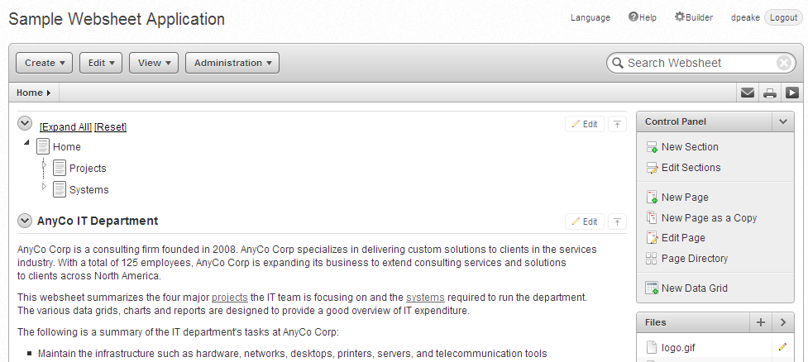
Oracle Application Express (Oracle APEX)
Websheets
Database enabled WIKI
Annotations (easily add files, links, notes, and tags)
Use [[SQL ]] tag
Presentation mode
Multi user
Notes:
Websheets are designed for business users rather than developers. They combine design and runtime into a common environment and is similar in operation to WIKIs.
The major difference between a WIKI and Websheets is that once you add data to a WIKI it becomes stale and dated, whereas with Websheets you can incorporate data elements directly into your pages.
Within a Websheet you can define data-grids ,which are spreadsheets stored in the Oracle Database, define reports on tables, or write SQL directly against tables within your Oracle Database schema.
Whenever a user accesses the Websheet page the data is now queried directly from the database.

